Slide 1
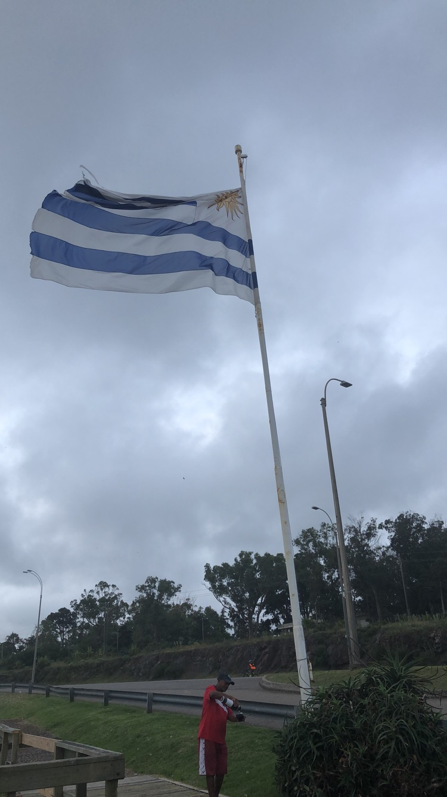
MBS- Missionary Bible School Who are we? We are a chosen people that have been called to the nations to do the will of God and expand his kingdom. We are not a part of one church but we are extended members of many churches focused on the kingdom of God and not the on the barriers of the church walls. Genesis 12:2 I will make you into a great nation, and I will bless you; I will make your name great, and you will be a blessing.
Notes:
Missionary bible school’s mission is to take the gospel to the nations children. Our goal is to plant seeds in these children that will change their life forever. We are determined to show the children that God wants a personal relationship with them and that serving God is fun. We do this via dance, singing, games, snacks and brining them blessings.
Isahia 66 where it talks about being a blessing and bringing the blessing to the people.

Slide 2
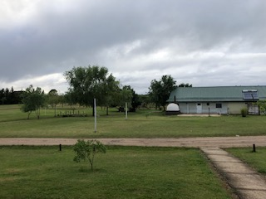
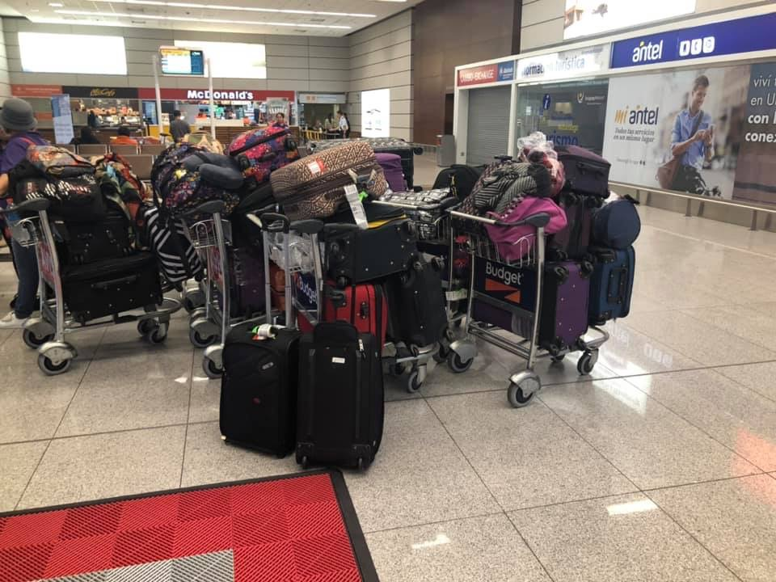
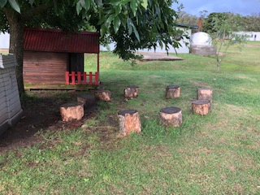
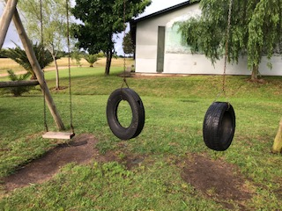
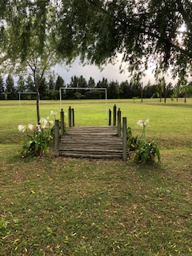
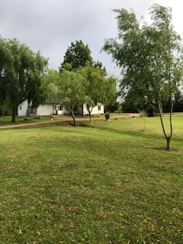
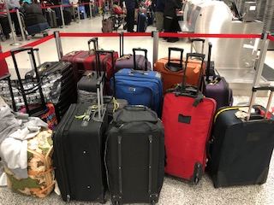
Notes:
This is the safe haven where we stayed and also where God ministered to me and healed me.

Slide 3
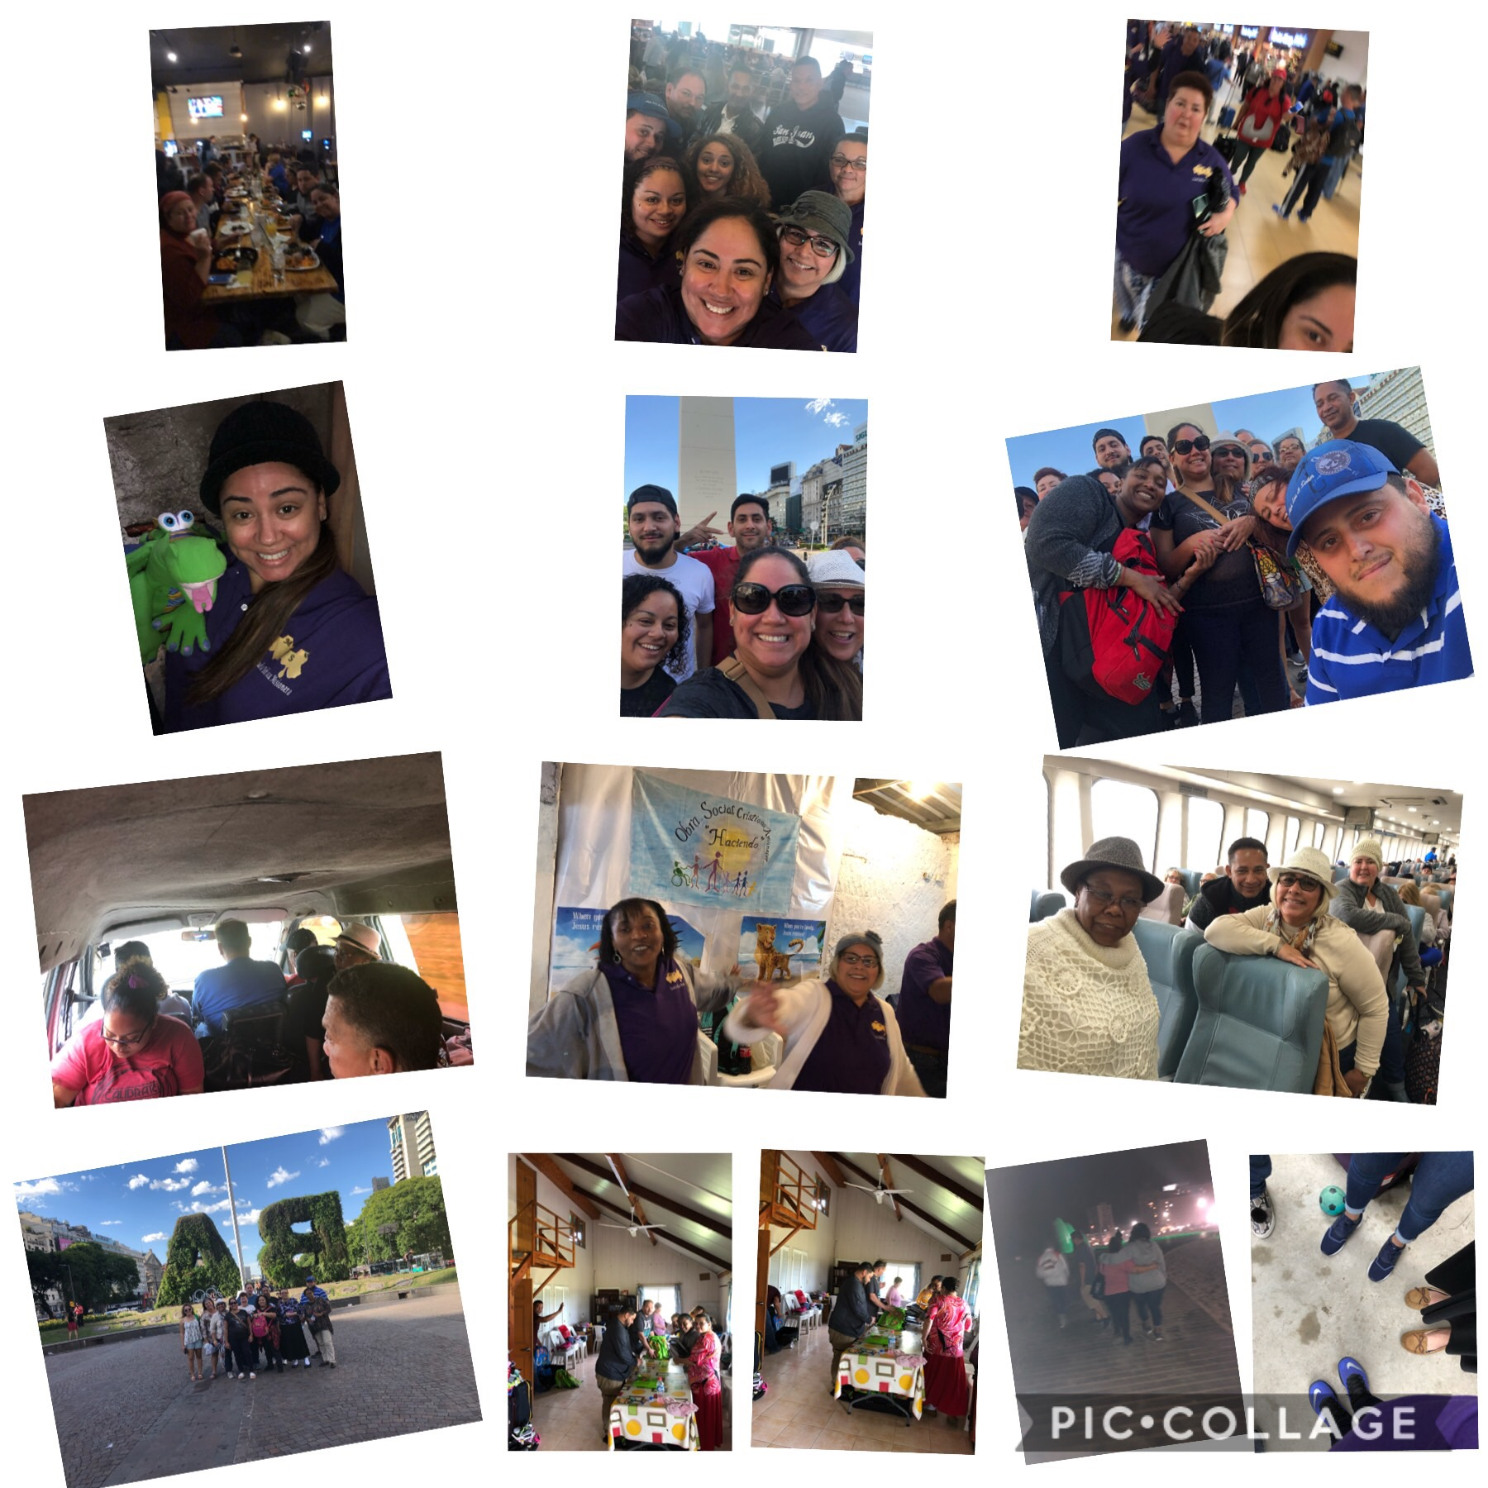

Slide 4
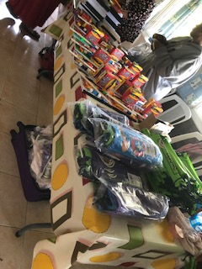
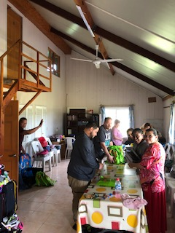
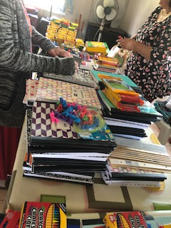
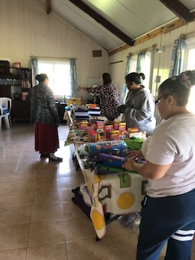
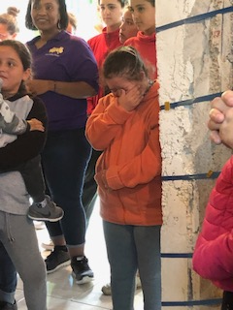
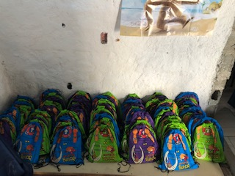
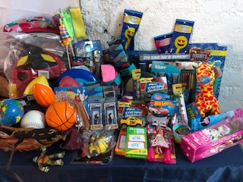
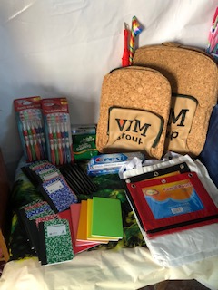
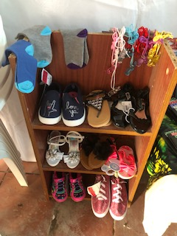
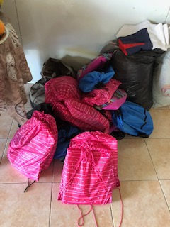
Notes:
Materials that were donated. School supplies and toys for the children. Also the MBS Team sorting everything by age and putting the book bags together. Some of our very own Kforcers were able to join in the blessing of others via their donations.

Slide 5
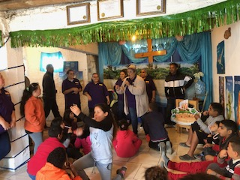
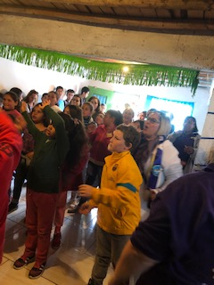
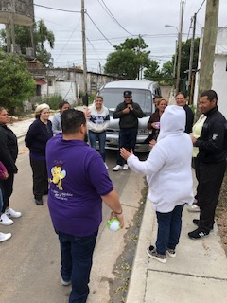
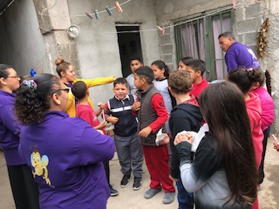

Slide 6
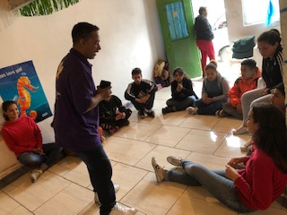
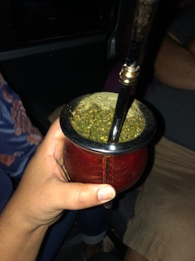
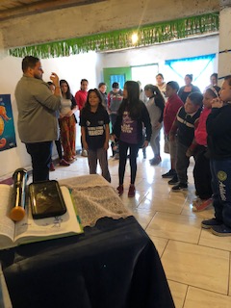
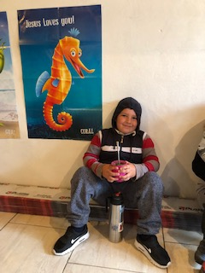
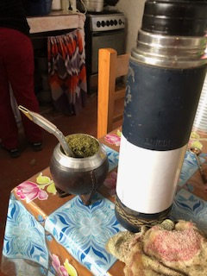
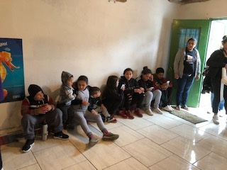
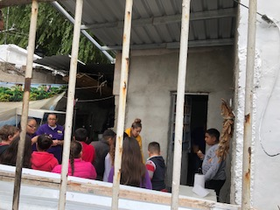

Slide 7
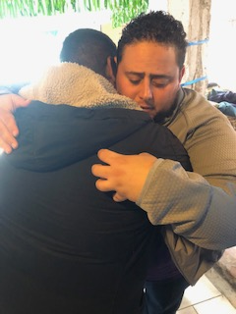
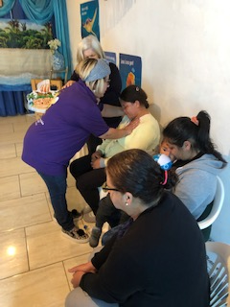
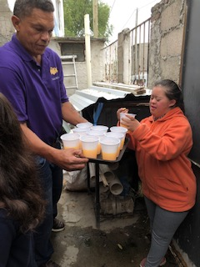
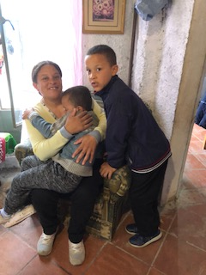
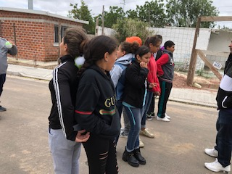

Slide 8
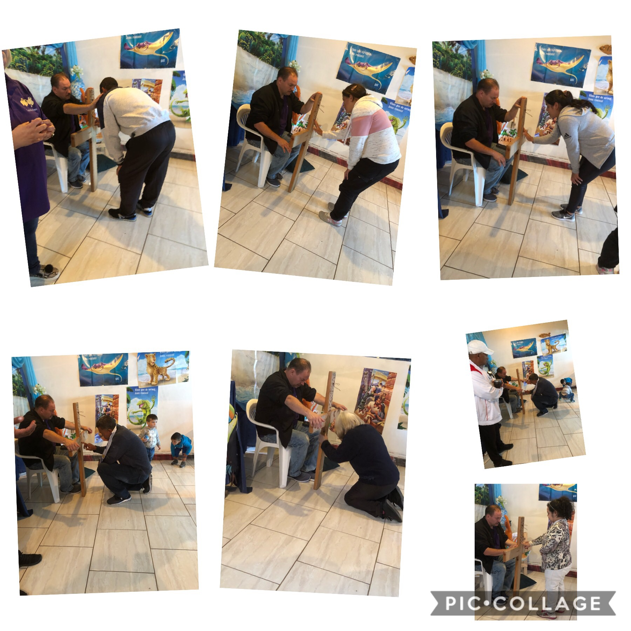
Notes:
The final day of MBS always leads the children and their parents to the cross. Rededication their life to Jesus and putting their finger print on the cross signifying their commitment and leaving their worries on the cross.

Slide 9
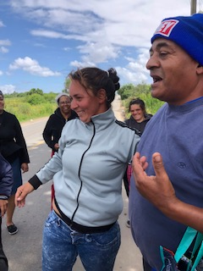
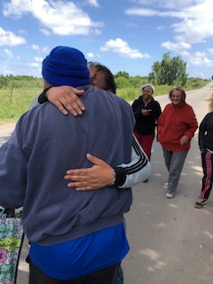
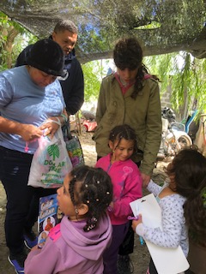
Notes:
The dump

Slide 10
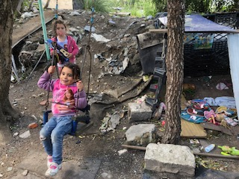
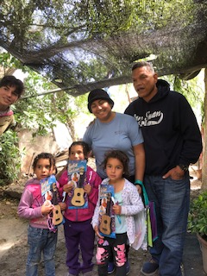
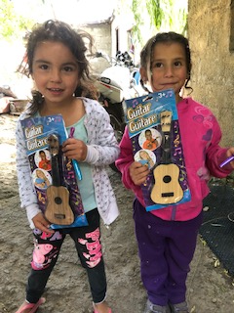
Notes:
The goal next year – These little girls are like the 12th generation from one family being born into these conditions. We are so blessed and we don’t know it. We complain because we don’t have money for lunch or the light bill is late but we’ve never seen true poverty.

Slide 11
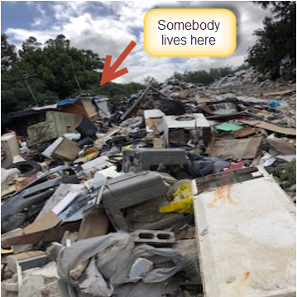
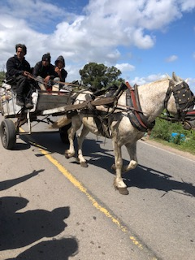
Notes:
On the back of that horse was a carriage full of food from the garbage that they were taking back home.

Slide 12
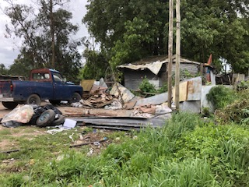
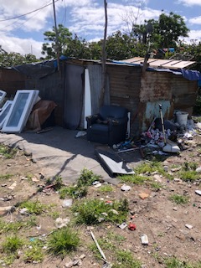
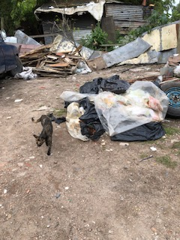
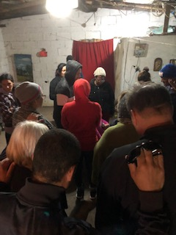

Slide 13
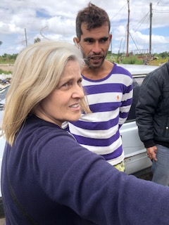
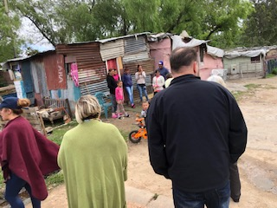
Notes:
They were so happy to receive and all the kids went throughout the neighborhood telling their friends and family about us and they ran up looking for their blessing.

Slide 16
Notes:
Miracles happen when you believe and call out to God. This pastor was about to throw in the towel and give up but he Loves God and he cried out to Him. We were the answer to his prayer. This land was given to their church but they didn’t have the funds to build there. They needed $1000 to put up a fence so that people wont be able to take over their land. After visiting this place our team collected this money between 10-12 people in 15 minutes.

Slide 17
Notes:
Finally… Ministry can be exhausting but very rewarding.

Slide 18
Notes:
By taking a leap of faith and going on this missionary trip I gained my strength back. I went to bless and ended up being blessed beyond measure.

